Slide 1
MALATTIA NON METASTATICA
Principali Novità luminal
Maria Vittoria Dieci
DiSCOG - UniPD
IOV – Istituto Oncologico Veneto I.R.C.C.S.

Slide 2
Disclosures
Eli Lilly: Personal fees for advisory boards/consultancy role, invited speaker
Novartis: personal fees for advisory boards/consultancy role
Pfizer: personal fees for consultancy role, invited speaker
Seagen: personal fees for advisory boards
Exact Sciences: personal fees for advisory boards
MSD: personal fees for advisory boards

Slide 3
Outline
Definition of ER expression cut-off
Adjuvant CDK4/6i
Genomic prognostic tests
PARPi for high risk gBRCAmut
Immunotherapy

Slide 4
Cut-off for ER-positivity: 1% vs 10%
DFS: ER-low vs ER-positive
DFS: ER-low vs ER-negative
Similar results for OS
Similar results for OS
BCs with ER expression 1%-9% should be reported as ER-low-positive (ASCO, ABC5)
Enrolment in clinical trials for TNBC should be allowed to patients with ER-low-positive BC
Paakkola N.-M., ESMO Open 2021; Allison KH, J Clin Oncol 2020; Cardoso F, Ann Oncol 2020

Slide 5
MONARCHE: STUDY DESIGN
N=5120 (91% of ITT)
60%
31%
N= 517 (9% of ITT)
Almost all received prior CT
Premenopausal at dg 43%
Power ~85%, HR 0.73 for IDFS, cumulative 2-sided alpha level of 0.05 (390 events primary analysis)
Pre-planned efficacy interim analysis, 75% iDFS events, 2-sided p-value < 0.0264 to claim positivity
O’Shaughnessy J, ESMO VP October 2021
Notes:
20% OFS
15% BFS
69% AI first on-study ET

Slide 6
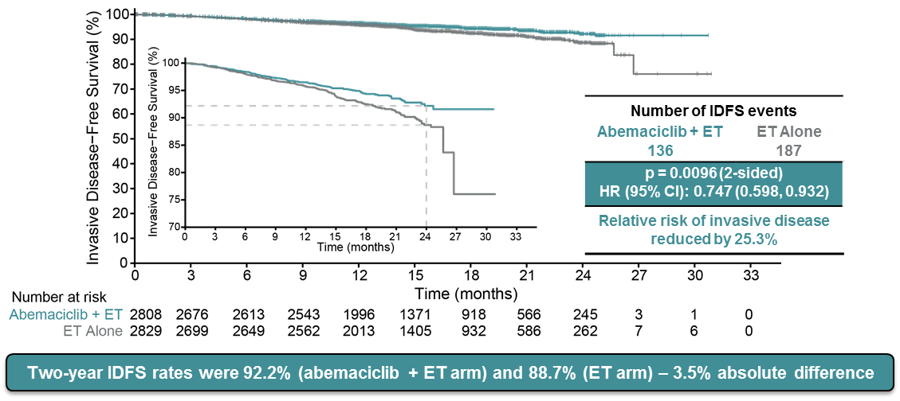
MONARCHE: PRIMARY ENDPOINT IDFS
323 iDFS events (82.8%), mFU ~15.5 months in each arm
Johnston S, ESMO 2020, JCO 2020

Slide 7
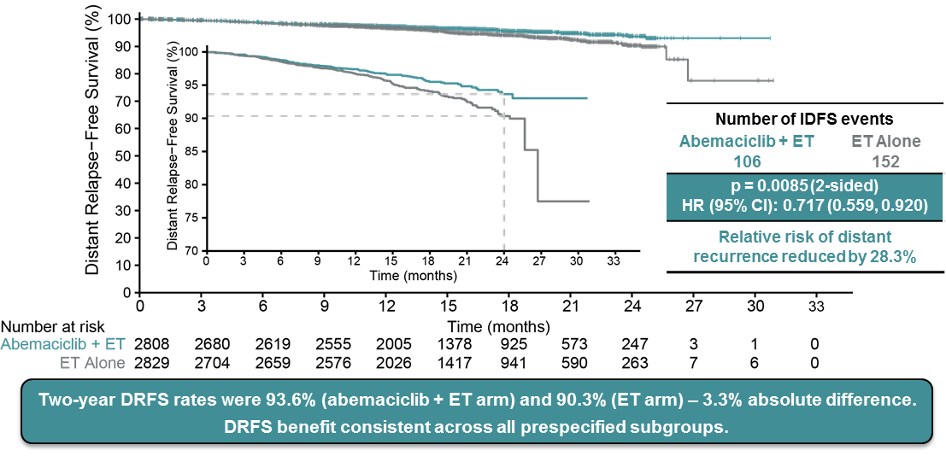
MONARCHE: SECONDARY ENDPOINT DRFS
Johnston S, ESMO 2020, JCO 2020

Slide 8
Updated analysis: ITT
Median FU 27 months
89.6% of pts off-study→ 72.2% completed the 2-yr treatment period, 17.4% discontinued prematurely
DRFS: HR 0.69, 95% CI 0.57-0.83; P<0.0001
3-year DRFS rates: abemaciclib + ET 90.3% versus ET alone 86.1%
Harbeck N, Ann Oncol 2021

Slide 9
Updated analysis: Ki-67 high populations
21%
34%
Harbeck N, Ann Oncol 2021
Notes:
Missing Ki67>20%

Slide 10
Updated analysis: Cohort 1 AND High Ki67
Harbeck N, Ann Oncol 2021
Notes:
Non è predittivo, beneficio relativo simile ma prognostico
Essendo comunque ambito di alto rischio per altri criteri di selezione il beneficio assoluto c’è anche in pazienti a prognosi migliore, che rimane comunque subottimale
Riproducibilità
Dati mancanti per oltre 20%, Ki67 low 34%
D’altra parte: follow up più lungo può essere più importante per pz a rischio più basso?
Overall immatura

Slide 11
The Panel also recommends that abemaciclib for two years plus ET for ≥5 years may be offered to the broader ITT population of patients with resected, HR-positive, HER2-negative, node-positive, early breast cancer at high risk of recurrence, defined as having 4+ LN, or as having 1-3 LN and one or more of the following features: histologic G3, T>5 cm, or Ki-67 index >20%.
(Type: evidence-based, benefits outweigh harms; Evidence quality: moderate; Strength of recommendation: strong).
node-positive HR+/HER2-, early BC
high risk: either 4 LNs, or 1-3 positive LNs with G3 and/or T3
Ki67 >20%
all three components required
https://www.fda.gov/drugs/resources-information-approved-drugs/fda-approves-abemaciclib-endocrine-therapy-early-breast-cancer; Spring l. et al, Ann Oncol 2021; https://www.asco.org/practice-patients/guidelines/breast-cancer#/11081

Slide 12
Adjuvant CDK4/6i:
MonarchE has formally established the superiority of abemaciclib + ET over ET alone in high risk early breast cancer. Benefit is maintained at further follow up.
Negative results with palbociclib so far from 2 trials (PALLAS and PENELOPE-B).
Potential advantages of abemaciclib possibly more relevant in early disease setting.
Waiting for NATALEE trial results.
Still to be clarified: duration of CDK4/6i, role of CDK4/6i vs CT, genomic classifiers for patients selection.

Slide 13
RxPONDER: iDFS in overall population by treatment arm
HR+/HER2-
N1-3
RS 0-25
~90%: 1-2 N+
(37% underwent SNB only)
85%-90%: G1-G2
Kalinsky K, SABCS 2020

Slide 14
RxPONDER: iDFS by treatment arm in post- and premenopausal pts
POST-MENOPAUSAL pts with RS 0-25 DID NOT BENEFIT from CT
PRE-MENOPAUSAL pts with RS 0-25 HAD BENEFIT from CT
Kalinsky et al, SABCS 2020

Slide 15
Piccart M, Ann Oncol 2021

Slide 16
Stadio I-IIIA, ER+/HER2-
Non indicazione per:
>4 linfonodi positivi
Basso o alto rischio
Paziente non candidabile a CT
Paziente che rifiuta CT

Slide 17
Slide 16

Slide 18
I-SPY2 trial: NACT +/- Pembrolizumab
Biomarker signature | Estimated pCR rate (95% interval) |  | Probability superior to control | Predictive probability of success in phase 3 trial
 | Pembro (n=69) | Control (n=181)
All HER2- | 44 (33-55) | 17 (11-23) | >99.9 | 98.5
HR+/HER2- (MP high risk) | 30 (17-43) | 13 (7-19) | >99.9 | 99.6
TN | 60 (44-75) | 22 (13-30) | 99.6 | 83.4
Nanda R, JAMA Oncol 2020

Slide 19
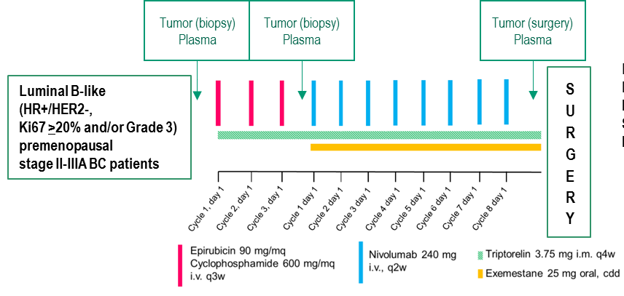
GIADA phase II trial: main results
pCR overall and by PAM50 subtype
TILs in pCR vs no pCR
TILs + Basal combined score
Dieci MV, Clin Cancer Res 2021

Slide 20
Ongoing neoadjuvant RCT of ICI + CT in HR+/HER2- BC
CheckMate 7FL
N=1200
ER+/HER2-
G3 or G2 with ER 1-10%
Paclitaxel→AC + Nivolumab/Placebo
(to be continuted in adj)
SAFETY FROM I-SPY-2 AND GIADA
I-SPY2
Endocrinopathies: Hypo/hyperthiroidism 13%, adrenal insufficiency 8.7% (5/6 G3-4)
G3 irAEs: hepatitis (n=2), colitis (n=1)
GIADA
G3 liver toxicity (17% ALT, 10% AST, 17% GGT)
G3 irAEs: erythema nodosus (n=1), pancreatitis (n=1)
Keynote-756
N=1140
ER+/HER2-, G3, ductal
Paclitaxel→AC + Pembrolizumab/Placebo
(to be continuted in adj)
Nanda R, JAMA Oncol 2020; Dieci MV, Clin Cancer Res 2021

