Slide 1
RIUNIONE ANNUALE GIM 2021
The prognostic role of endocrine resistance/sensitivity classification according to
the ESO-ESMO international consensus guidelines for advanced breast cancer:
analysis of patient level data from the GIM and MIG studies
Study coordinators: Eva Blondeaux, Matteo Lambertini
Study statisticians: Eva Blondeaux, Luca Boni

Slide 2
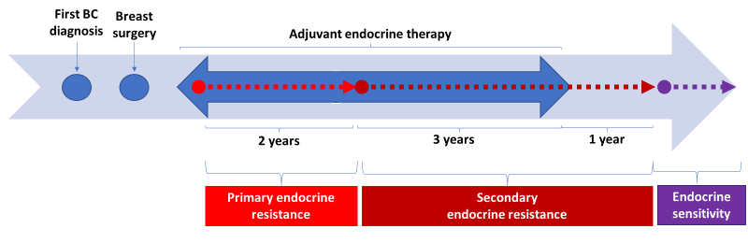
BACKGROUND
Adjuvant endocrine therapy (ET) significantly reduces the risk of relapse and death among patients with hormone receptor positive early breast cancer. However, up to 20% of these patients will experience relapses in the first 10 years from diagnosis, either with loco-regional disease or with distant metastases ¹
European School of Oncology (ESO) and European Society for Medical Oncology (ESMO) classification ²:
¹EBCTCG, Lancet 2015; ² Cardoso F et al, Ann Oncol 2020

Slide 3
THE GIM AND MIG STUDIES
Study | No. of patients | Arms | Median follow-up (yrs) | No. of DFS/EFS events | No. of distant relapses | No. of HR+ pts | No. of DFS/EFS events in HR+ pts | No. of distant relapses in HR+ pts
GIM2 | 2091 | FEC-P dose dense FEC-P standard interval EC-P dose dense EC-P standard interval | 7.0 | 521 | 232* | 1611 | 359 | 160*
GIM3 FATA | 3697 | Letrozole for 5 yrs Anastrozole for 5 yrs Exemestane for 5 yrs Tamoxifen for 2 yrs→ Letrozole for 3 yrs Tamoxifen for 2 yrs→ Exemestane for 3 yrs Tamoxifen for 2 yrs→ Anastrozole for 3 yrs | 5 | 401 | 183 | 3697 | 401 | 183
GIM4 LEAD | 2056 | Letrozole for 2-3 yrs (5 yrs of ET) Letrozole for 5 yrs (7-8 yrs of ET) | 11.7 | 474 | 158 | 2056 | 474 | 158
GIM6 PROMISE | 281 | CT alone CT + GnRHa | 12.4 | 87 | 40 | 226 | 70* | 31*
MIG1 | 1214 | FEC dose dense FEC standard interval | 15.8 | 494 | 220* | 650 | 265 | 141*
MIG5 | 1055 | FEC x6 EP x 4 | 12.8 | 422 | 226 | 809 | 323* | 144*
TOTAL | 10394 |  |  | 2399 | 1059 | 9049 | 1892 | 817

Slide 4
OBJECTIVES
Primary objective
To compare the overall survival (OS), defined as time between date of distant disease-free survival event (DDFS) and death, in three groups of patients: i) primary endocrine resistant or ii) secondary endocrine resistant or iii) endocrine sensitive disease.
Secondary objectives
To assess OS in the three groups according to patient’s age, nodal status, tumor size, estrogen receptors and progesterone receptors status (ER+/PgR+, ER+/PgR-, ER-/PgR+, Other), prior local therapy, prior (neo)adjuvant chemotherapy and type of prior (neo)adjuvant chemotherapy, type and duration of endocrine therapy received
To assess OS in patients experiencing relapse after the completion of adjuvant ET according to the timing of relapse (early vs late relapses, defined as relapse within or after 5 years from the completion of adjuvant treatment)
To describe timing and patterns of recurrence over time in the included trials according to the different patients’ characteristics
To assess calibration and discriminatory accuracy of the CTS5 score and the PREDICT+ tool

