Slide 1
NUOVE PROPOSTE
Dr. Giuseppe Buono
IRCCS INT F. Pascale, Napoli

Slide 2
Trastuzumab-deruxtecan
Sacituzumab-govitecan

Slide 3
Trastuzumab-deruxtecan (T-DXd) in the treatment of metastatic breast cancer (MBC): a Real world retrospective and prospective/translational study on patients enrolled in the expanded access program (EAP)
Background
Antibody-drug conjugates (ADCs): monoclonal antibodies chemically linked to highly potent cytotoxic drugs, designed to deliver the cytotoxic payload directly to the target cancer cells
T-DXd composed of: 1) an anti-HER2 humanized monoclonal immunoglobulin G1 antibody, 2) a cleavable maleimide tetrapeptide linker (selectively cleaved by cathepsins upregulated in cancer cells and tumor microenvironment), 3) the exatecan derivative MAAA-1181A (DXd), a DNA topoisomerase I inhibitor with a 10-fold higher inhibitory potency compared with SN-38 (active metabolit of irinotecan)
T-DXd demonstrated activity in heavily pre-treated (median 6 lines) HER2+ MBC patients: ORR 60.9%, DCR 97.3%, CBR 76.1% and mPFS 16.4 months. Activity also in HER2-low MBC: ORR: 37%, mDOR 10.4 months
Recently showed impressive superiority over T-DM1 in the Destiny-Breast 03 study: mPFS NR vs. 6.8 months (HR 0.28) and ORR 79.7% vs. 34.2%.
Mechanisms of action: DXd specific delivery to HER2 overexpressing cells; bystander effect; pre-clinical data of immunostimolatory activity

Slide 4
Sacituzumab govitecan in the treatment of metastatic breast cancer (MBC): a Real world prospective/translational study on patients enrolled in the expanded access program (EAP)
Background
Sacituzumab govitecan (SG) is an ADC in which SN-38 (an active metabolite of irinotecan), a topoisomerase I inhibitor, is coupled to an humanized antitrophoblast cell-surface antigen 2 (Trop-2) monoclonal antibody through the cleavable CL2A linker.
IMMU-132-01 phase I/II basket trial: in a cohort of 108 TN patients, receiving SG as third or higher line of therapy, ORR of 33.3%, mPFS of 5.5 months and mOS of 13 months. Interesting activity also in 54 HR+/HER2- pts: ORR of 31.5%, mPFS of 5.5 months, and mOS of 12 months.
Confirmatory phase III ASCENT trial in TNBC pts treated with ≥ 2 prior lines of therapy: SG superior over treatment of physician choice (TPC) in terms of PFS (5.6 vs 1.7 months), OS (12.1 vs 6.7 months) and ORR (35% vs. 5%).

Slide 5
Studies aims:
To retrospectively/prospectively evaluate efficacy and safety of T-DXd and SG in patients enrolled in the EAP
To prospectively perform a translational analysis concerning biomarkers of response/resistance and tumor-immune system interaction

Slide 6
Studies aims:
To retrospectively/prospectively evaluate efficacy and safety of T-DXd and SG in patients enrolled in the EAP
To prospectively perform a translational analysis concerning biomarkers of response/resistance and tumor-immune system interaction

Slide 7
Retrospective/Prospective cohort:
Efficacy analysis in terms of ORR, CBR, DCR, mPFS and mOS in overall population and in clinical relevant subgroups: brain metastases, older patients, co-morbidities, etc
Toxicity analysis through CTCAE and the Toxicity over time approach (ToxT)
Post-progression treatments’ choice and efficacy

Slide 8
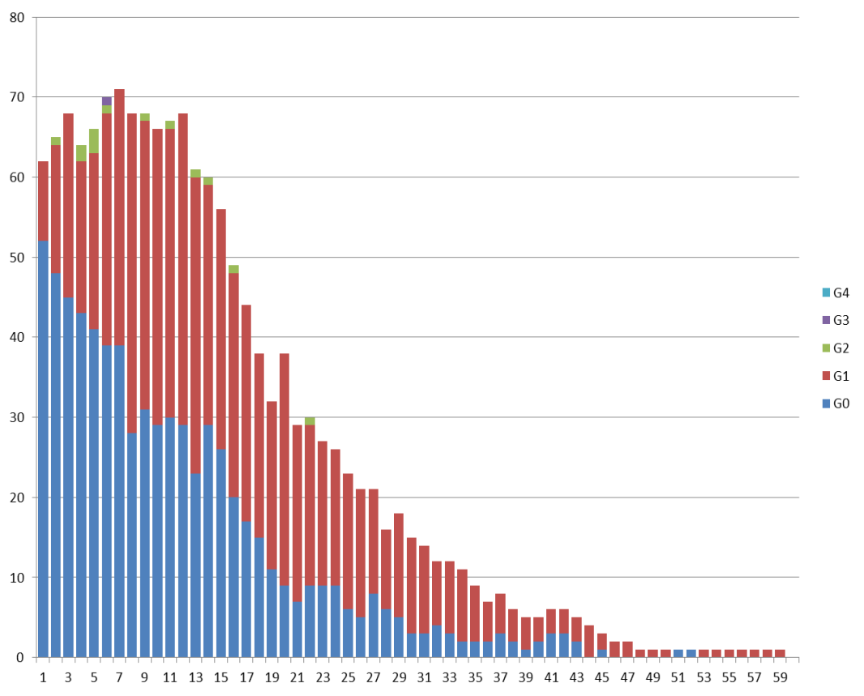
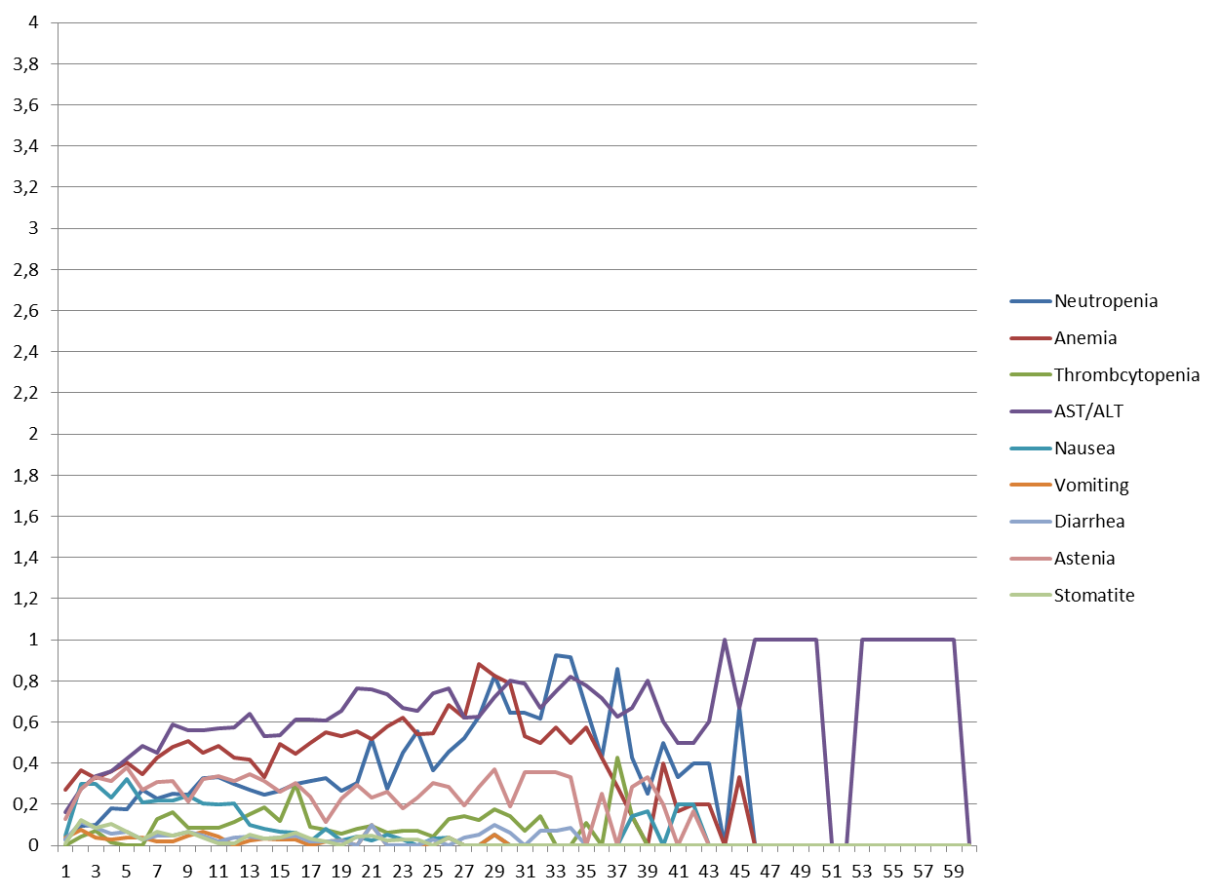
Toxicity over Time:
International randomized studies often report AEs as the incidence of the highest-grade event, as defined by the Common Terminology Criteria For Adverse Events (CTCAE)
This approach lacks in the possibility to answer to important clinical questions, such as when a specific AE occurs, what is its mean grade, how long it lasts and, importantly, if its severity is modified over time
To overcome this issues and more comprehensively describe AEs including time-related informations, Thanarajasingam et al. developed an analytic and standardized approach, defined Toxicity over Time (ToxT)
Individual AEs at each time point
AEs trajectory Over Time
AST / ALT
Number of patients
Mean CTCAE grade
Cycle of T-DM1
Cycle of T-DM1
Unpublished data

Slide 9
Studies aims:
To retrospectively/prospectively evaluate efficacy and safety of T-DXd in patients enrolled in the EAP
To prospectively perform a translational analysis concerning biomarkers of response/resistance and tumor-immune system interaction

Slide 10
Translational analysis:
- Serum and plasma collection at baseline, 21 day, 3 months (1st evaluation), every 3 months until disease progression (ctDNA, exploratory analysis on: timidine kinase1, circulating exosomes, other analysis to be defined)
- Microbiome stool test at baseline, first evaluation and at PD
Baseline
Day 21
First imaging
Every 3 months until progression
Liquid biopsy

Slide 11
Timidine Kinase: catalyzes the phosphorylation of thymidine to thymidine monophosphate, which plays a critical role in the synthesis of DNA. Levels and activity of TK1 (cytosolic form) low or undetectable in resting cells, peaking markedly from late G1 to late S-phase in proliferating cells.
TK1 in BIOITALEE
TK1 in 142 MBC pts
TK1 in 125 eBC pts treated with NACT
Malorni et al. ESMO 2021
Laarson et al. Scientific reports 2020
Matikas et al. ESMO Open 2021
Notes:
TK1 can be measured through a peripheral blood draw and quantified via ELISA-based assays, thus may represent a noninvasive and widely accessible means of estimating prognosis at baseline, as well as monitoring response throughout treatment.
The broad applicability of TK1 as a marker of prognosis and early resistance to a uniform regimen may represent an appealing clinical and research tool.

Slide 12
Immunity and ADCs
One of mechanisms of immune activation by CT is activation of dendritic cells followed by activation of T cells
Topoisomerase-I inhibitors demontrasted to stimulate T-cell killing activity and an immunomodulatory effect
Contribution of DS-8201a to immune
memory formation
Contribution of adaptive immunity for effect
of DS-8201a
In mice cured with DS-8201a, inoculated HER2+ or negative cells were rejected, whereas these cells grew in naive mice
In immunocompetent mice, intratumoral T cells significantly increased at day 8 compared with vehicle controls. When CD8+ cells were depleted, anti-tumor effect of DS-8201a was negated (data not shown)
Iwata et al. Mol Cancer Ther 2017

Slide 13
Immunity and ADCs
Upregulation of intratumoral Dendritic cells
by DS-8201a
Increased expression of tumor-associated molecules on tumor cells by DS-8201a
In immunocompetent mice eight days after DS-8201a, the ratio of DCs to lymphocytes significantly increased in DS-treated vs. vehicle controls
In immunocompetent mice eight days after DS-8201a, mean fluorescence intensity (MFI) of PDL-1 and MHC class I significantly increased in DS-treated vs. vehicle controls
Iwata et al. Mol Cancer Ther 2017

Slide 14
Gut microbiome: interplay between CT toxicity and immune stimulation
- Clinical studies demontrated impairment in gut microbiome by chemotherapeutic agents
- Gut microbiome is implicated in immune system activation
- Correlation between gut microbiome and ICI response
- Immuno-stimolatory effects of ADCs: potential implication of gut microbiome in treatment response/resistance?
Aims:
Baseline characterization of gut microbiome and correlation with disease response to ADCs
To explore whether changes in the overall diversity of gut microbiome correlate with disease response to treatment

