Slide 1
Test genetico e molecular tumor boards: modelli di percorsi al servizio dell’accesso ai farmaci
Filippo Montemurro
Direzione Day Hospital Oncologico Multidisciplinare
Istituto di Candiolo, FPO-IRCCS
Riunione Annuale GIM Padova 25/11/2021

Slide 2
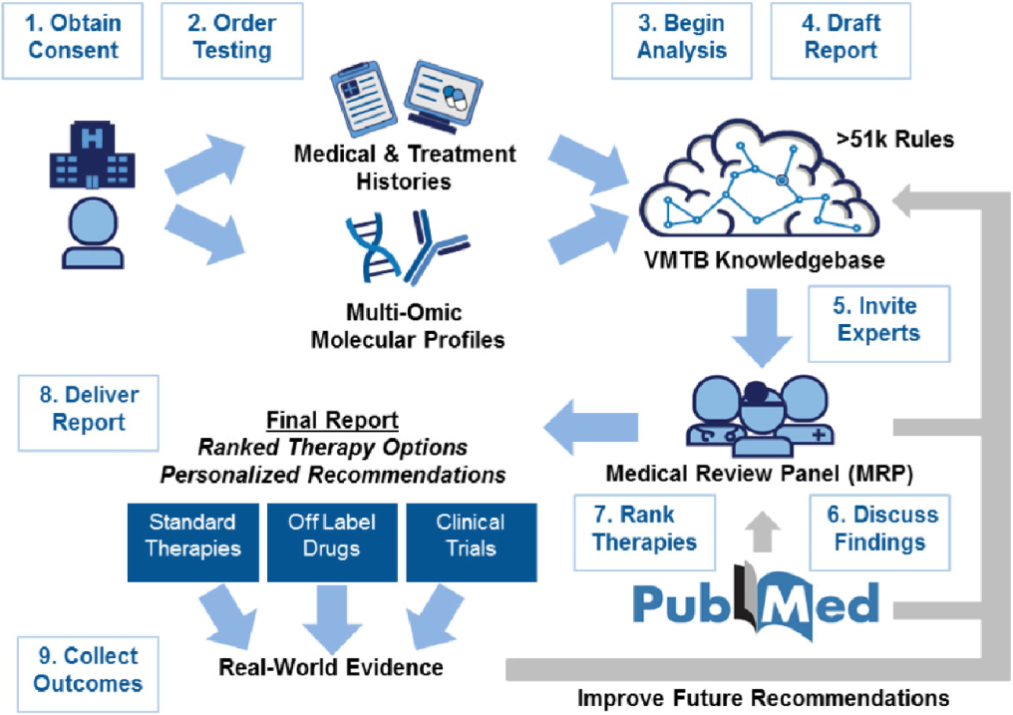

Why ″Molecular Tumor Board (MTB)″?
NEXT GENERATION
SEQUENCING
NGS
Multidisciplinary Team (MDT)
Molecular Tumor Board (MTB)

Slide 3
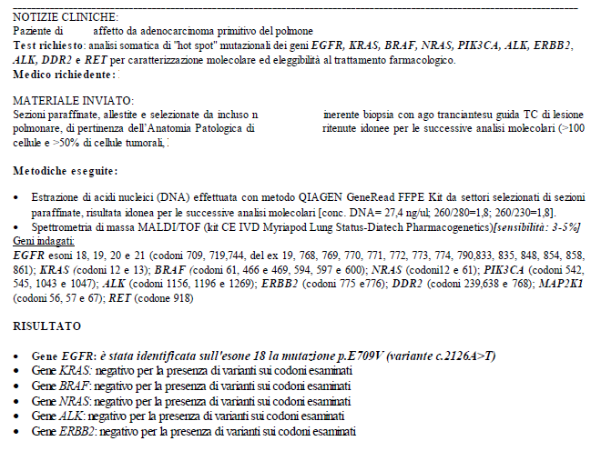
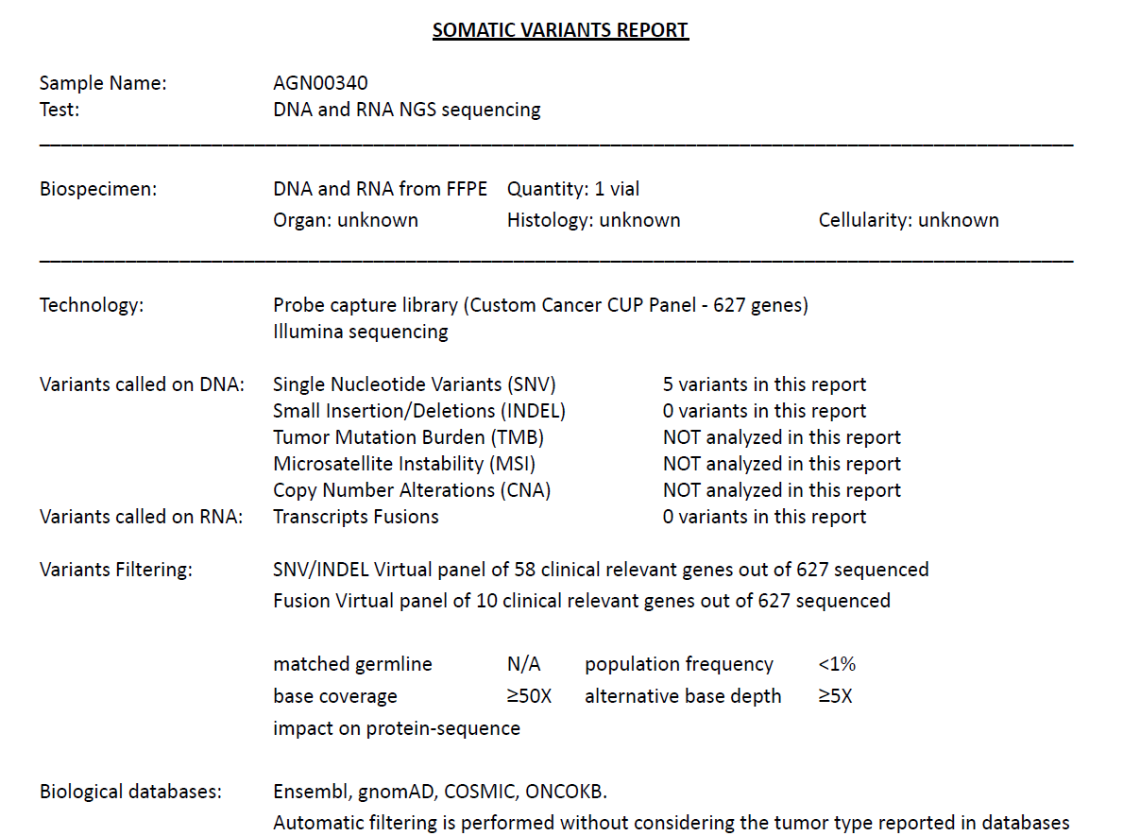
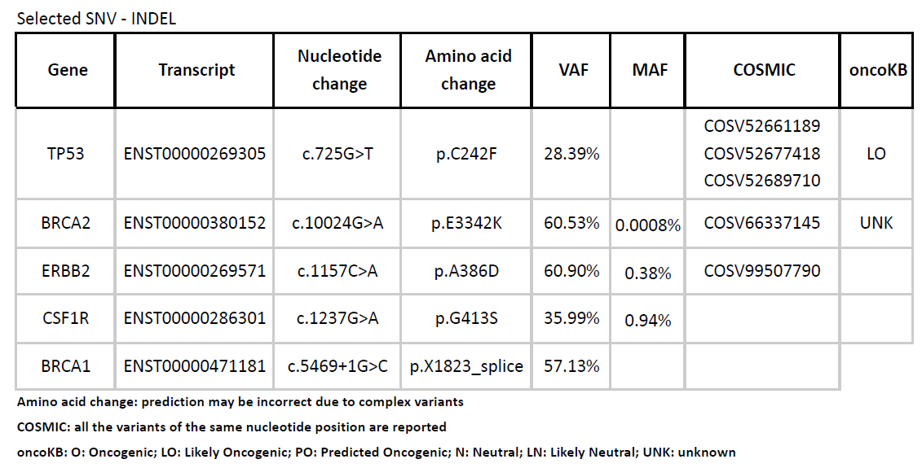
Differences in Molecular Diagnostic Reports at a glance
Targeted Hot Spot Analysis
Whole exhome Analysis of multiple genes
Candiolo CUP Project

Slide 4
Characteristics of an NGS report
Type of genetic material sequenced
Source
Technology
What is analyzed and what is not analyzed
Filtering
Performance of the test (coverage, depth)
Biological Databases
Test output:
Mutated gene
Transcript Code
Nucleotide Change
Amino Acid Change
VAF
MAF
COSMIC matching
OncoKB matching
Candiolo CUP Project

Slide 5
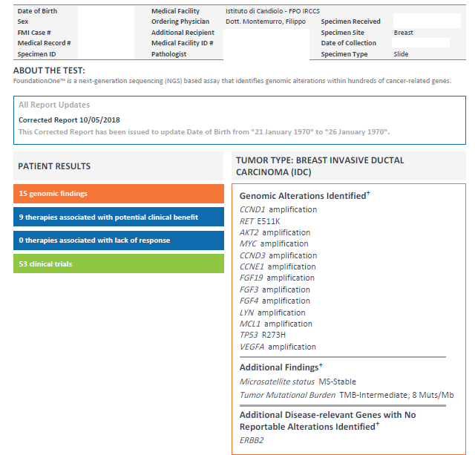
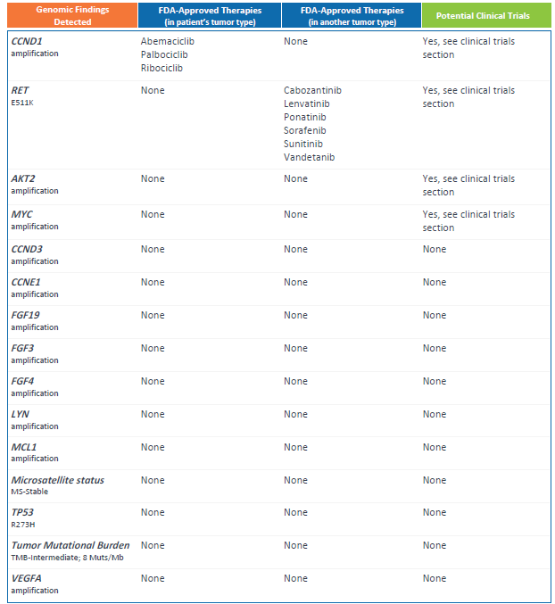
Commercially available tests provide results interpretation and potential druggability

Slide 6
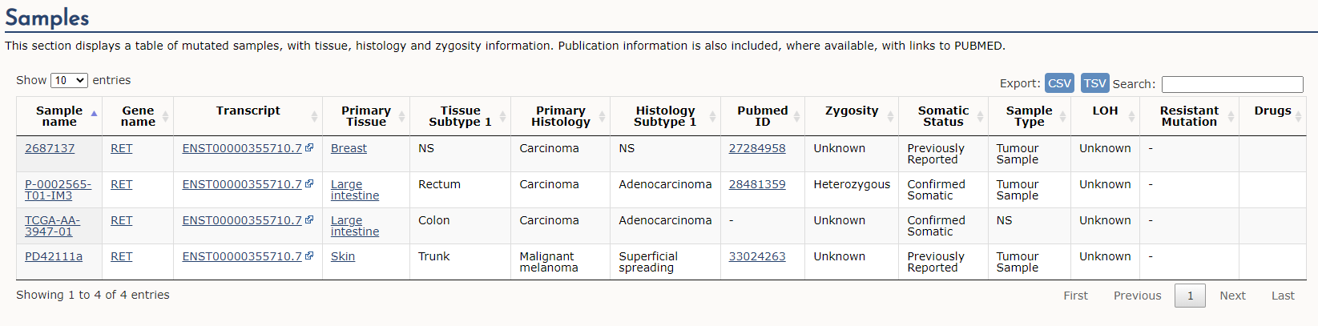
Cosmic Interpretation of the RET p.E511K mutation found in this patient

Slide 7
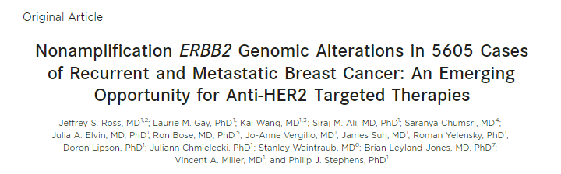
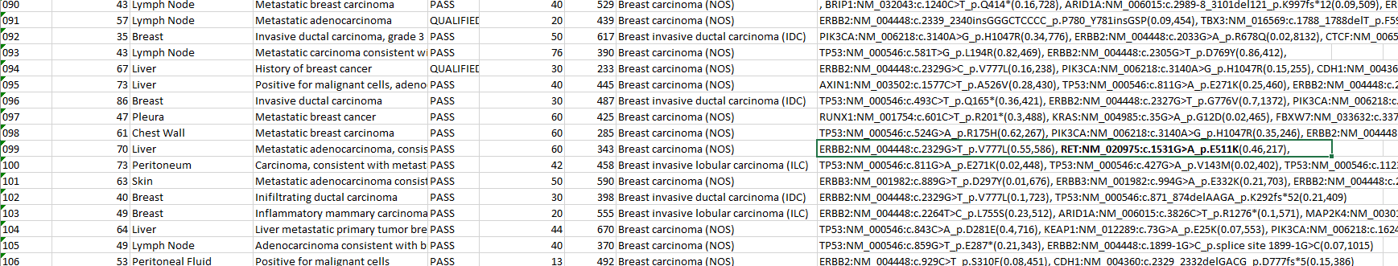
Pubmed hit for RET p.E511K mutation
Ross et al, Cancer 122;2654, 2016

Slide 8
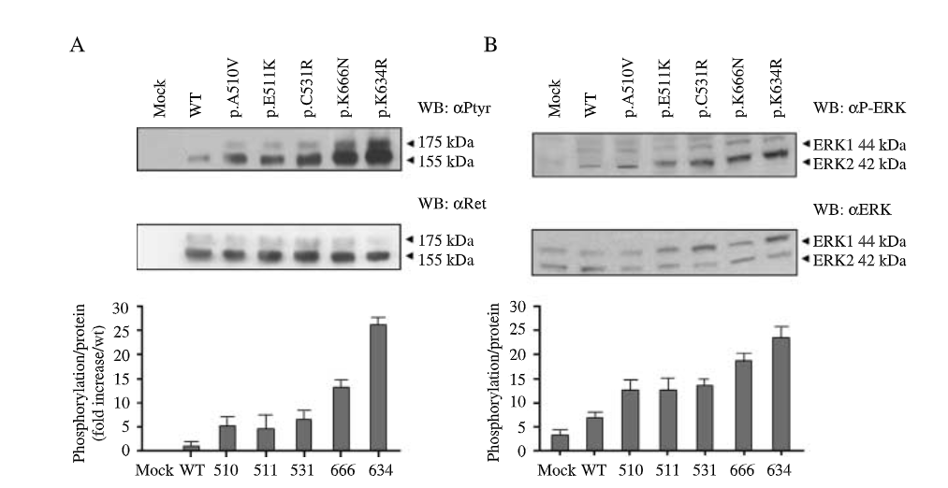
Is RET p.E511K oncogenic?
Pubmed search string ”Ret” and ("p.E511K" or "c.1531G>A")”
Muzza et al, Eur j Endocrinol 162; 771, 2010

Slide 9
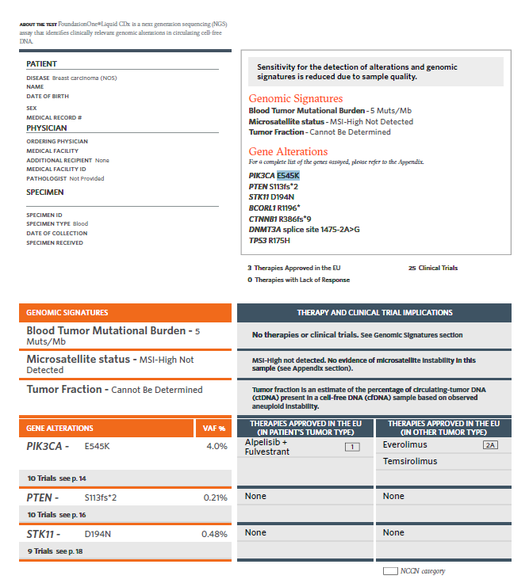
A second example
Courtesy of Prof Fabio Puglisi

Slide 10
Mutational analysis in the Solar Study
Before enrollment, cohort status was centrally determined according to the presence or absence of any PIK3CA mutation by means of polymerase chain-reaction analysis of mutation hot spots in the C2, helical, and kinase domains of PI3K (corresponding to exons 7, 9, and 20, respectively)
  Andrè et al NEJM 2019
All PIK3CA mutations were previously reported, with almost 90% occurring in exon 9 (32.9%) or 20 (53.9%). Median PFS was longer in patients with wild-type PIK3CA in both treatment arms than in those with mutations, with a slightly greater reduction in risk of progression with everolimus versus placebo. For wild-type PIK3CA, the HR was 0.37; (95% CI, 0.25 to 0.55), and for mutated PIK3CA, the HR was 0.51 (95% CI, 0.34 to 0.77; interaction P 5 .35). These findings suggested that PIK3CA mutations only minimally affected the efficacy of everolimus (Fig 2A, Table 2).
  Hortobagyi et al, J Clin Oncol 2015

Slide 11
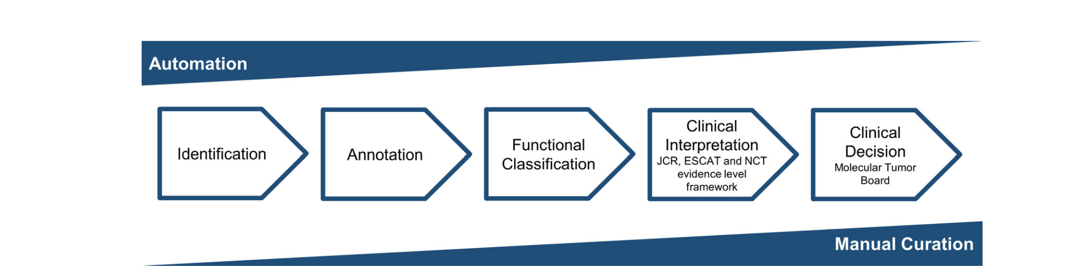
Take-home message: technology is outstanding, yet, manual curation plays a crucial role in order to contestualize results and provide real opportunities
Horak et al, Genes Chromosomes Cancer 202;1, 11

Slide 12
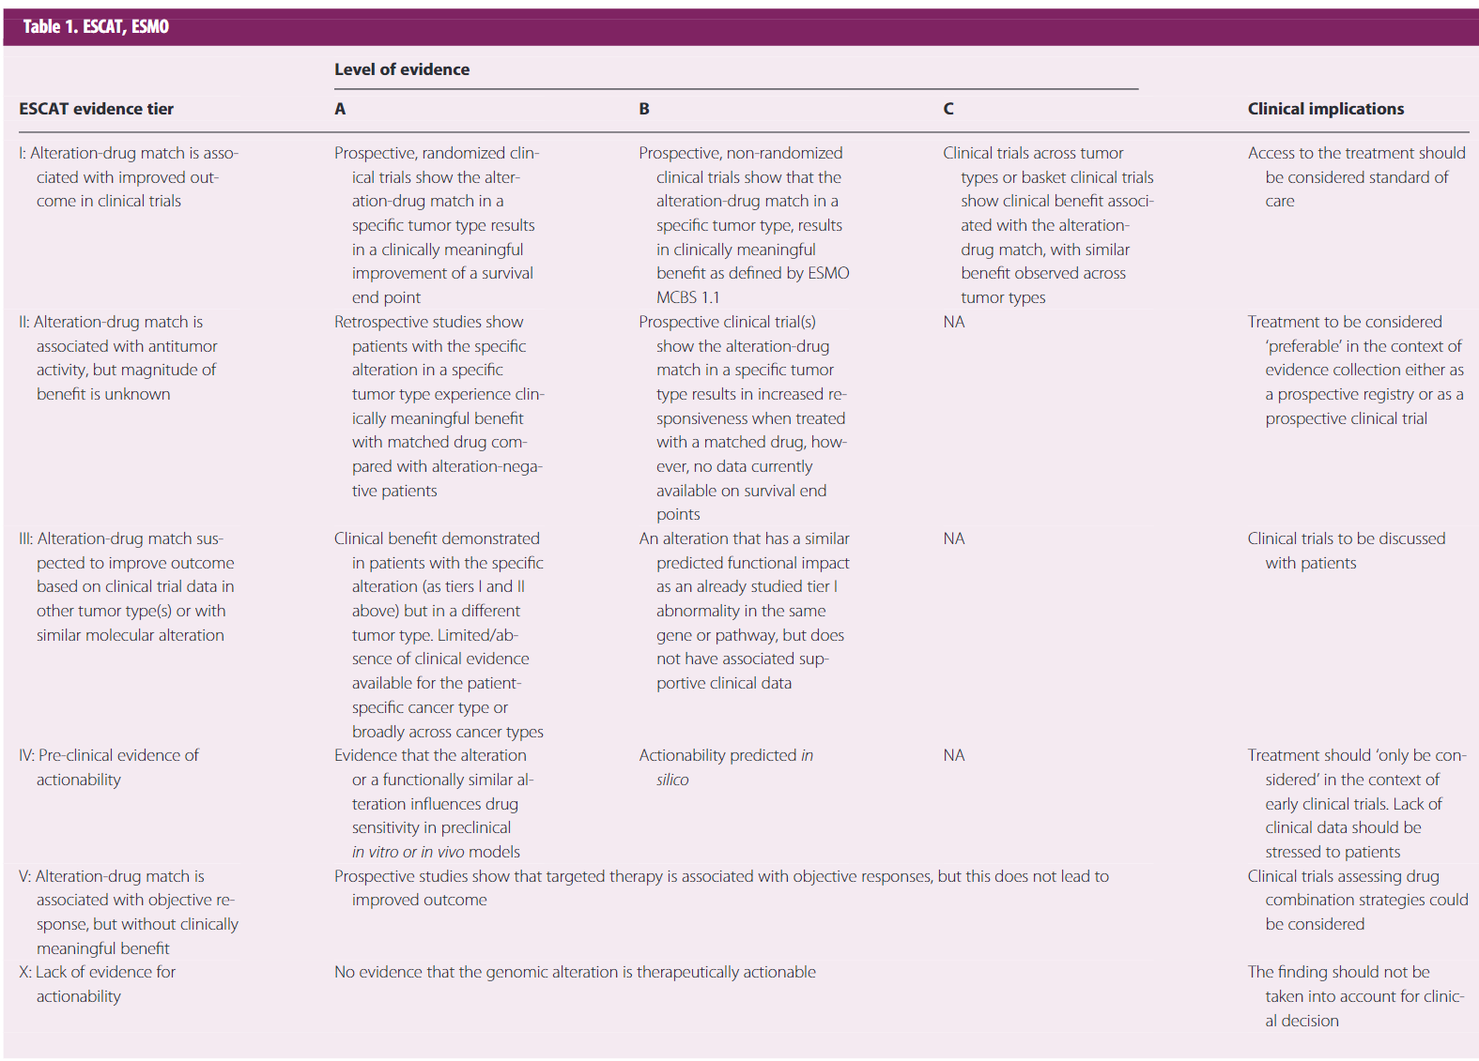
ESCAT; actionability scale
Condorelli et al, Ann Oncol 30;356, 2019

Slide 13
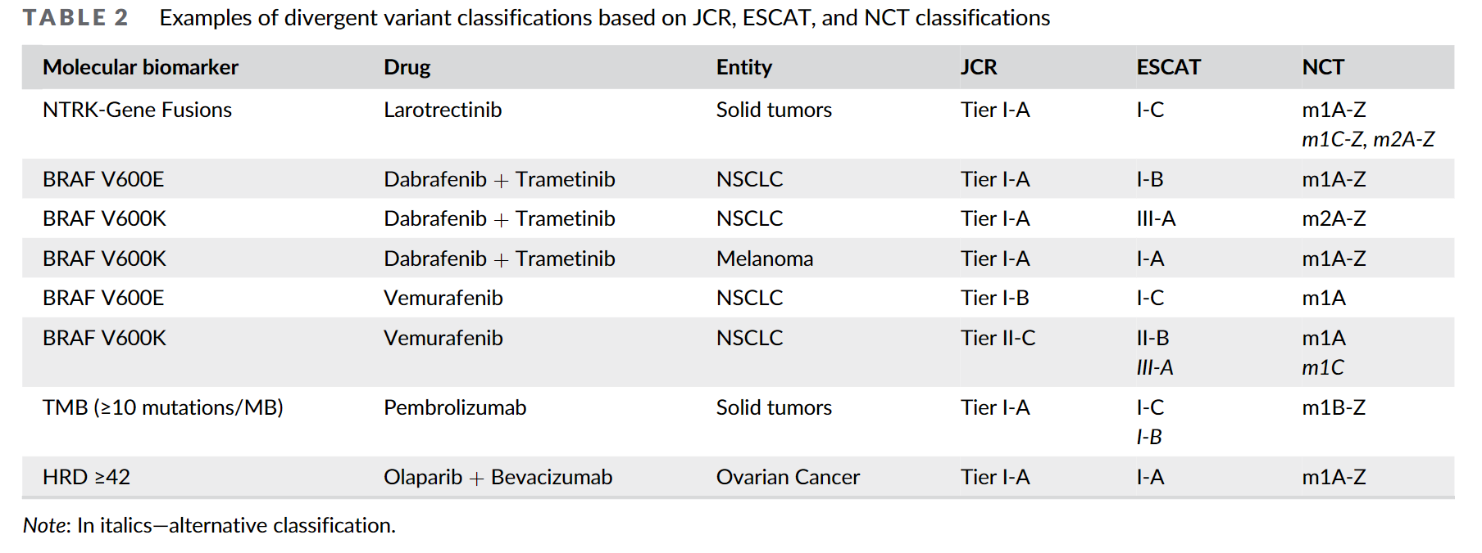
Possible divergence in different actionability scales
Horak et al, Genes Chromosomes Cancer 202;1, 11

Slide 14
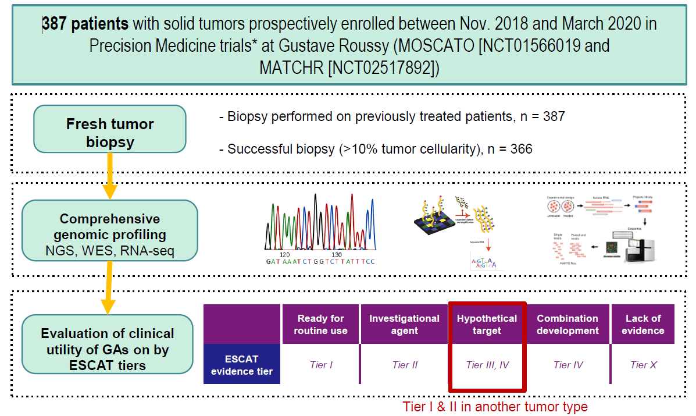
Does the genetic test offer opportunities to patients?
Romano et al, ESMO 2020

Slide 15
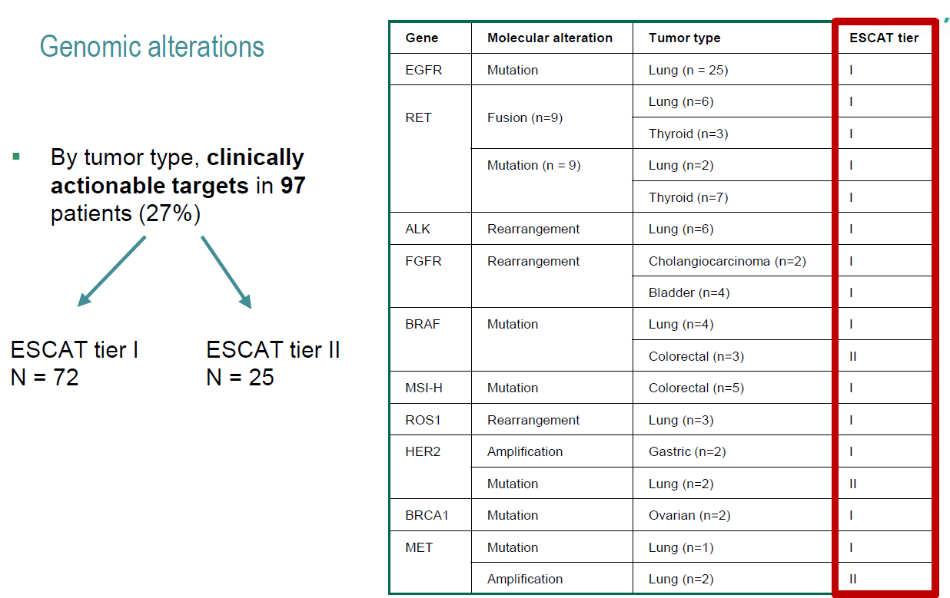
Results
Romano et al, ESMO 2020

Slide 16
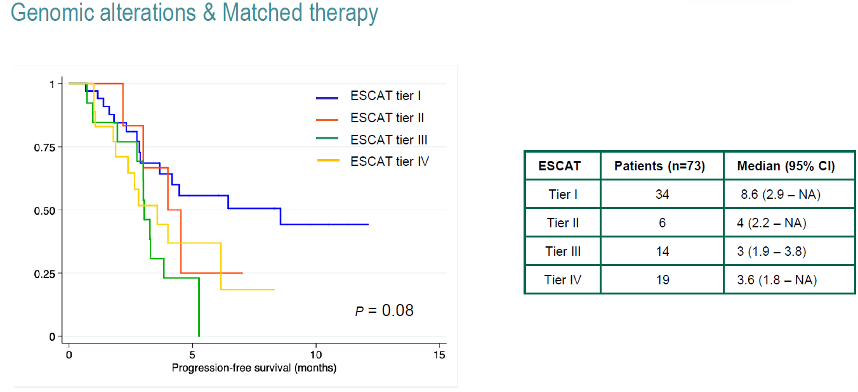
Results
Romano et al, ESMO 2020

Slide 17
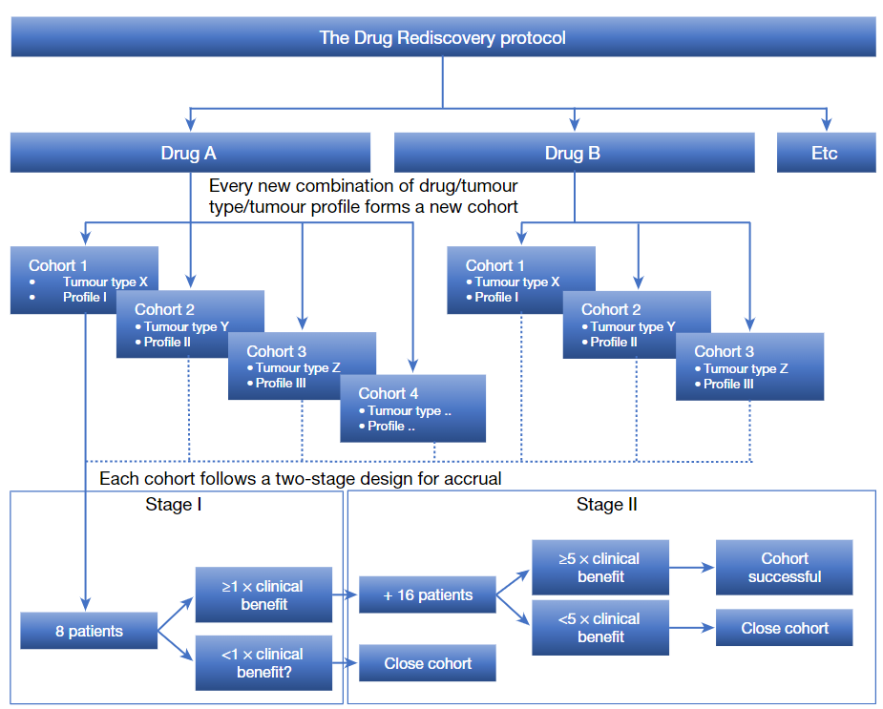
The Drug Rediscovery Protocol
Van Der Velden et al, Nature 574;128, 2019

Slide 18
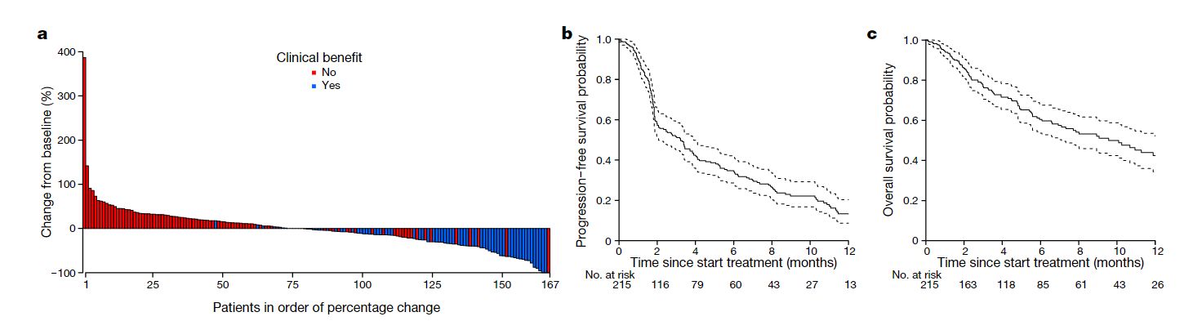
Clinical results in 215 treated patients
Clinical Benefit* in 34% of 215 patients
136 with targeted agents
79 with immunotherapy
*Defined as CR or PR od SD @16 weeks
Van Der Velden et al, Nature 574;128, 2019

Slide 19
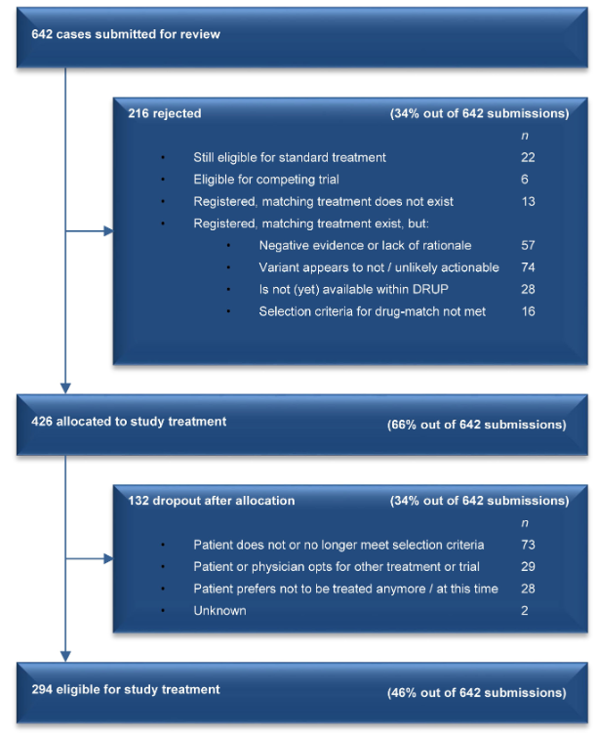
Real Efficiency
73 with CB/642 = 11%
Van Der Velden et al, Nature 574;128, 2019

Slide 20
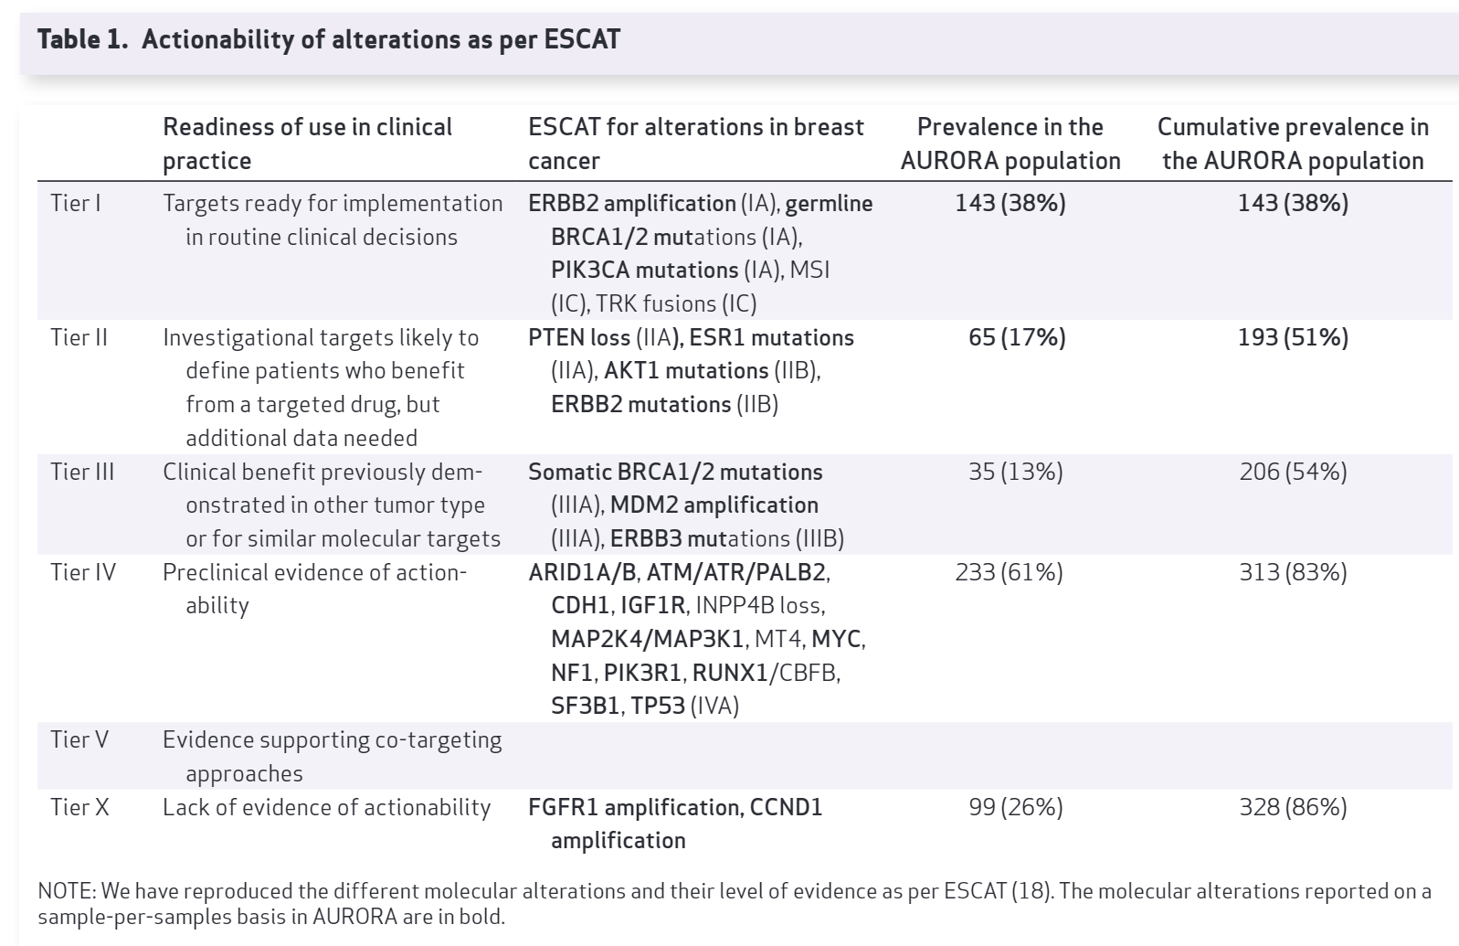
Focus on breast cancer: the Aurora Study
Afrtimos et al, Cancer Discov Nov 2021

Slide 21
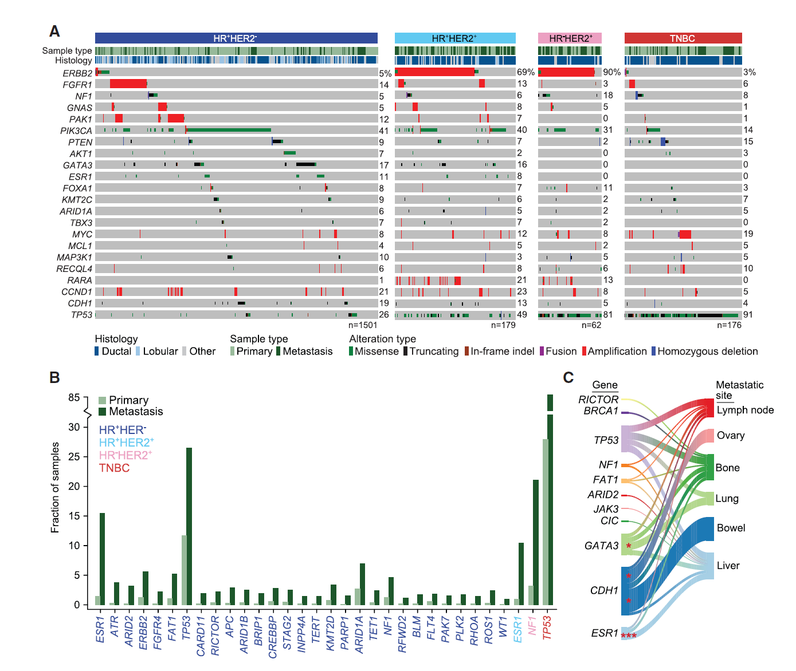
Focus on breast cancer
Razavi et al, Cancer Cell 34;427, 2018

Slide 22
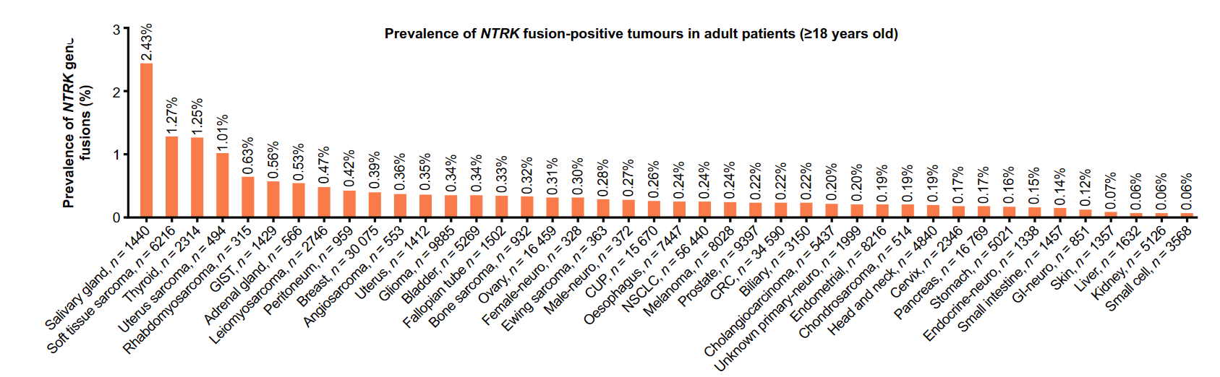
The case of NTRK fusion
Westphalen et al, Npj Precision Oncology 69, 2021
SN=0.99
SP=0.99
P =0.0039
PPV = (0.0039*0.99)/(0.0039*0.99)+(1-0.0039)*(1-0.99) = PPV circa 28%
https://www.medcalc.org/calc/diagnostic_test.php

Slide 23
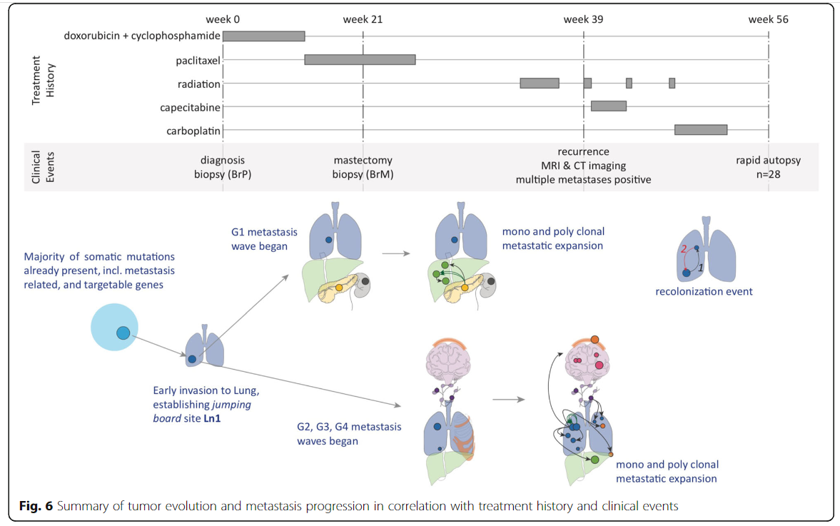
Clonal and subclonal evolution of MBC
Huang et al, Genome Medicine, 13;170, 2021

Slide 24
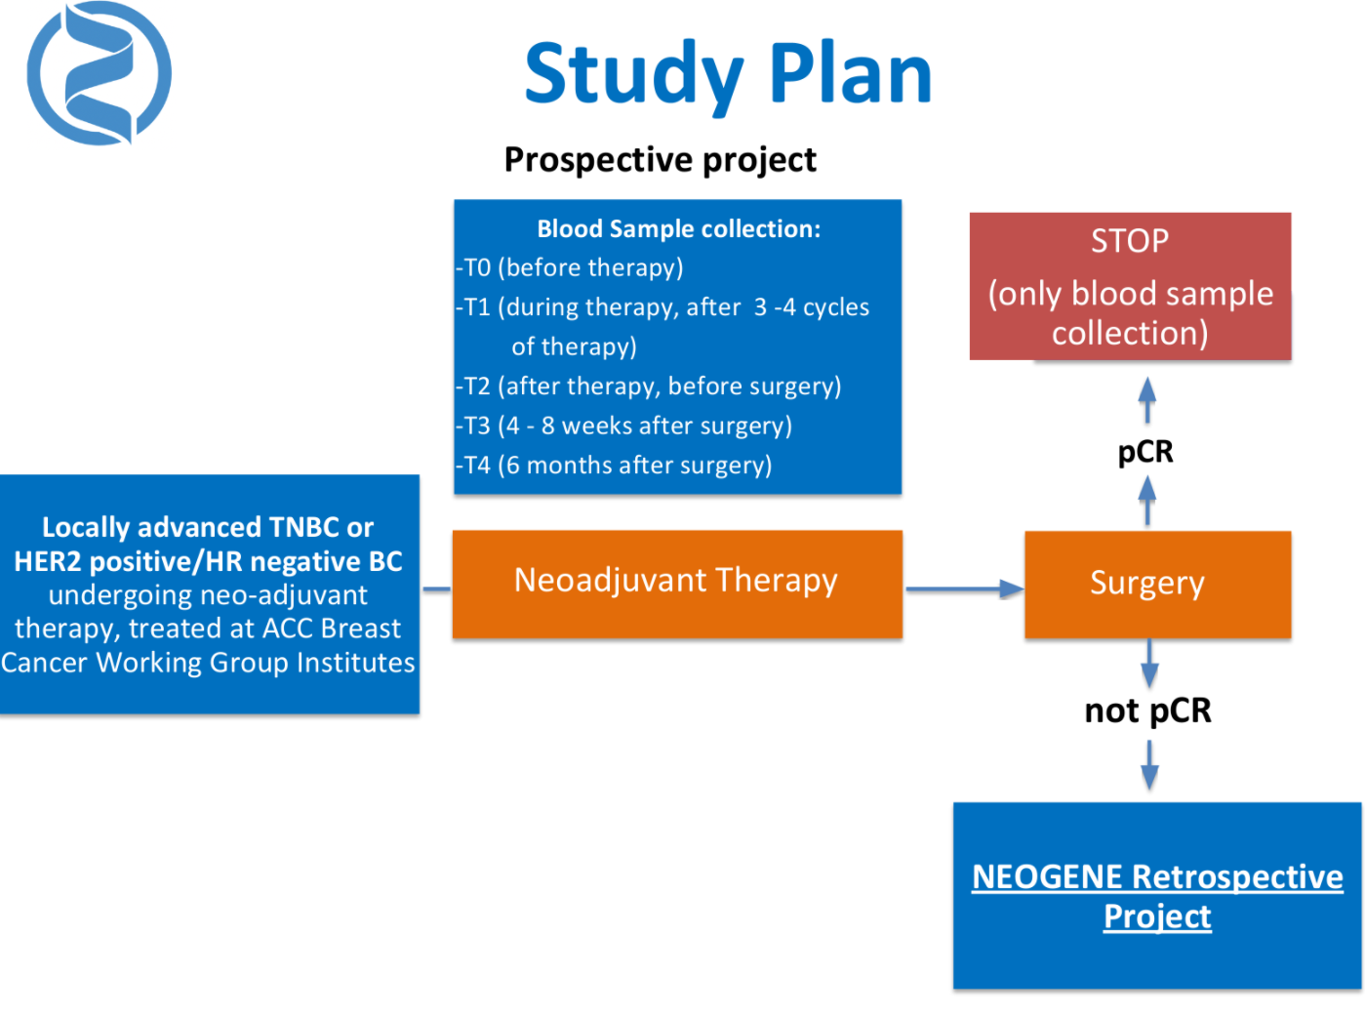
Neogene

Slide 25
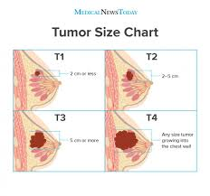
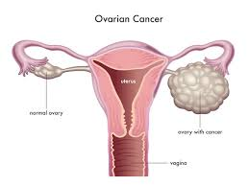
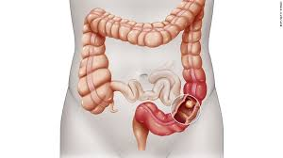

Ongoing studies: GERSOM Study
295 cancer genes
172 cancer predisposing genes
226
104
Prevalence in
each disease setting
68
196
Pharmacogenomic variants

Slide 26
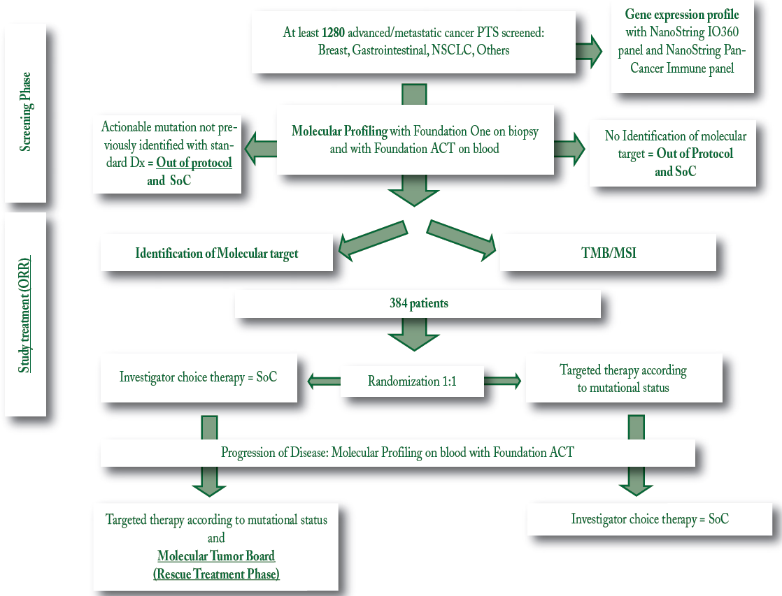
Rome Study

Slide 27
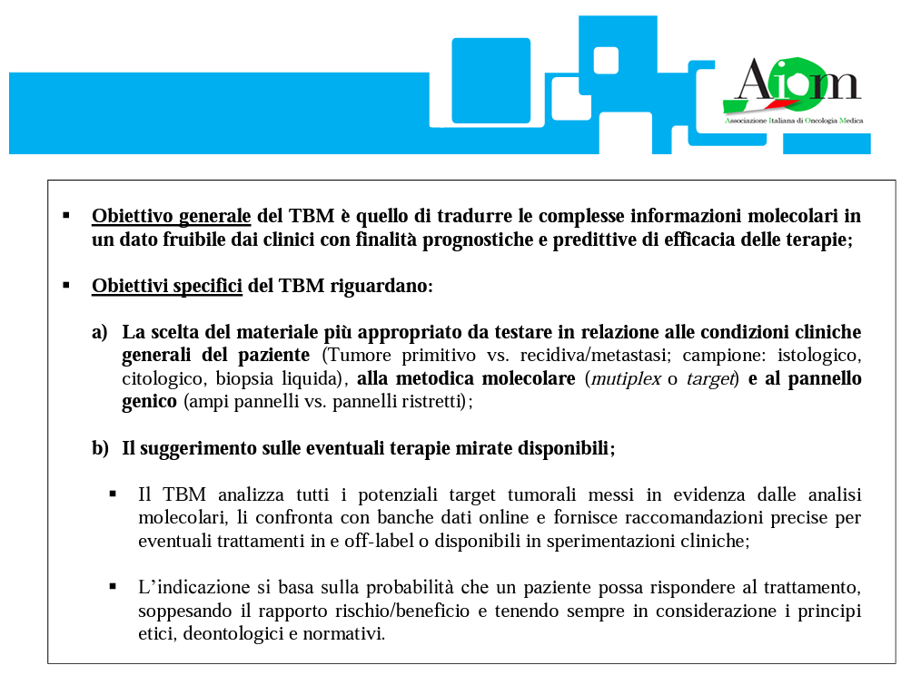
Conclusions:
• Uno o più Oncologi;
• Ematologo;
• Anatomopatologo;
• Patologo molecolare;
• Patologo clinico;
• Biologo molecolare esperto di “profiling” molecolare e/o “drug repositioning”;
• Data manager;
• Bioinformatico;
• Biostatistico;
• Genetista;
• Radiologo;
• Radioterapista;
• Farmacista;
• Segretario
2020

Slide 28
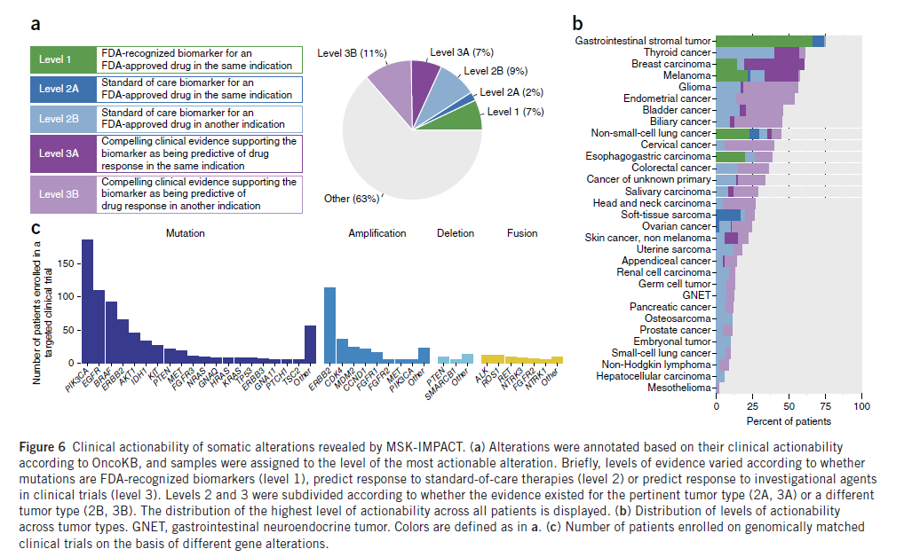
Does NGS offer additional (compared to conventional, targeted testing) to patients?
Zehir et al, Nat Med 2017

Slide 29
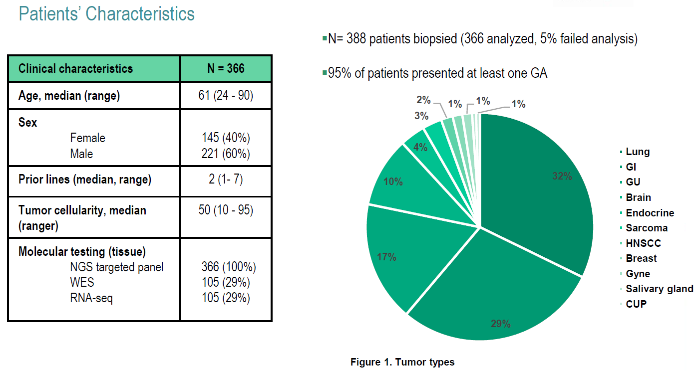
Results
Romano et al, ESMO 2020

