Slide 1
The INSPIRE.1 Study
Incidence of liquid biopsy-detectable MRD (lbMRD)
in HER2 positive MBC after radiological Complete Response
Lorenzo Gerratana, MD
Department of Medicine (DAME) - The University of Udine, Italy
Department of Medical Oncology (OMP) - IRCCS CRO Aviano National Cancer Institute, Italy
GIM Annual Meeting - New study proposals

Slide 2
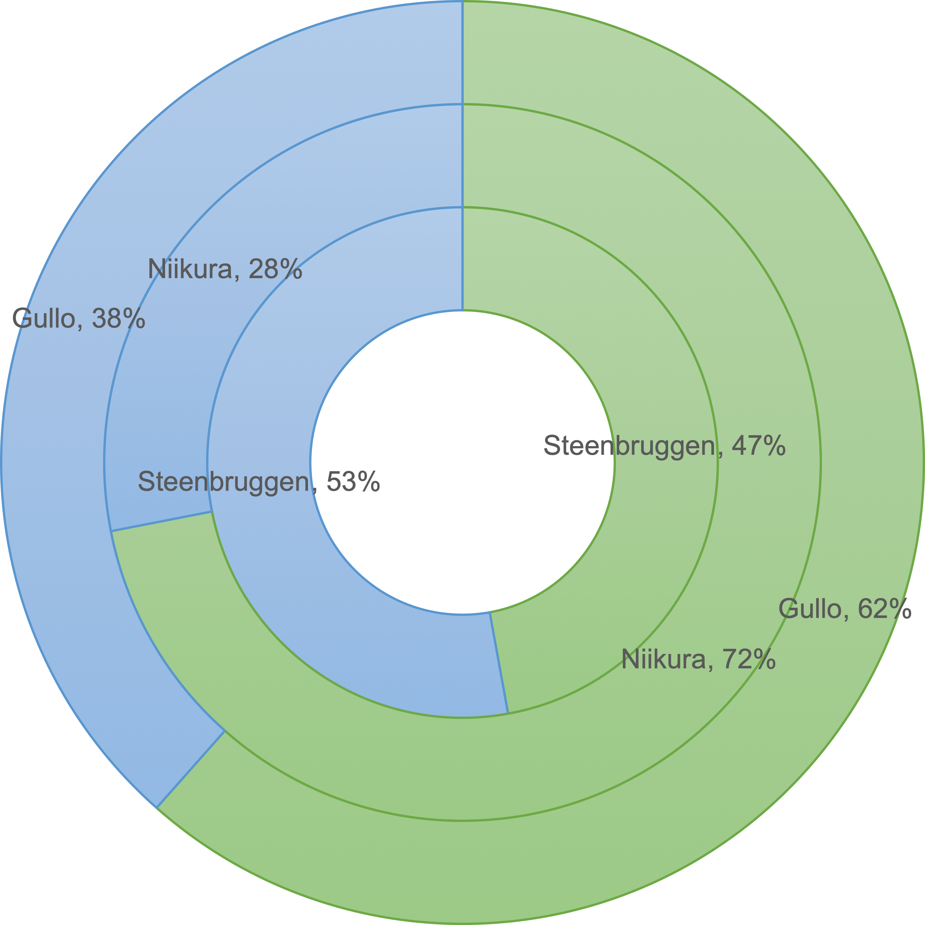
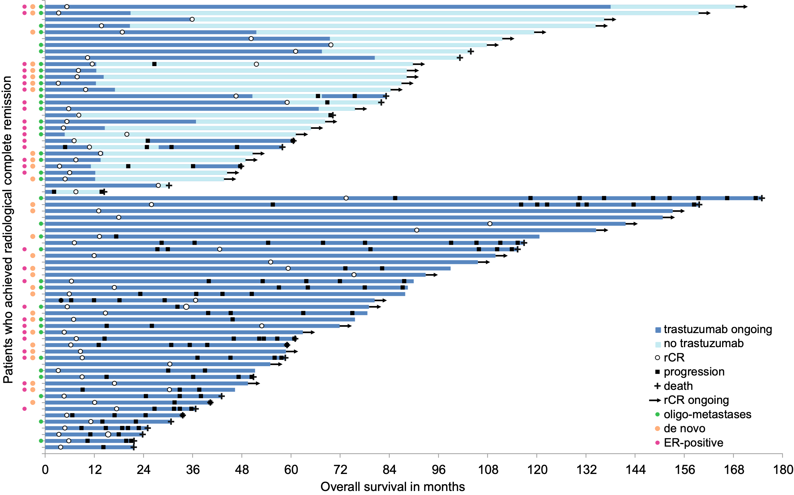
A science of uncertainty and an art of probability
HER2 positive MBC with rRC: an unmet clinical need
Steenbruggen TG, Bouwer NI, Smorenburg CH, et al. Breast Cancer Res Treat, 2019; doi:10.1007/s10549-019-05427-1

Slide 3
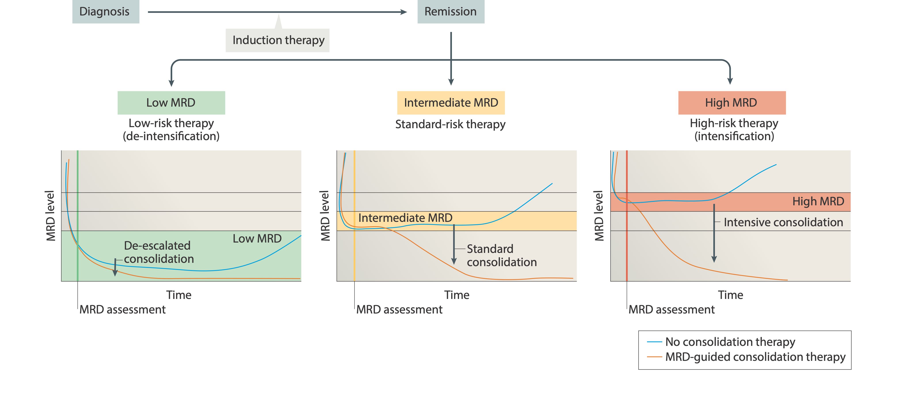
Targeting what you cannot see
Minimal residual disease and treatment intensity
Luskin MR, Murakami MA, Manalis SR, Weinstock DM. Nat Rev Cancer, 2018; doi:10.1038/nrc.2017.125

Slide 4
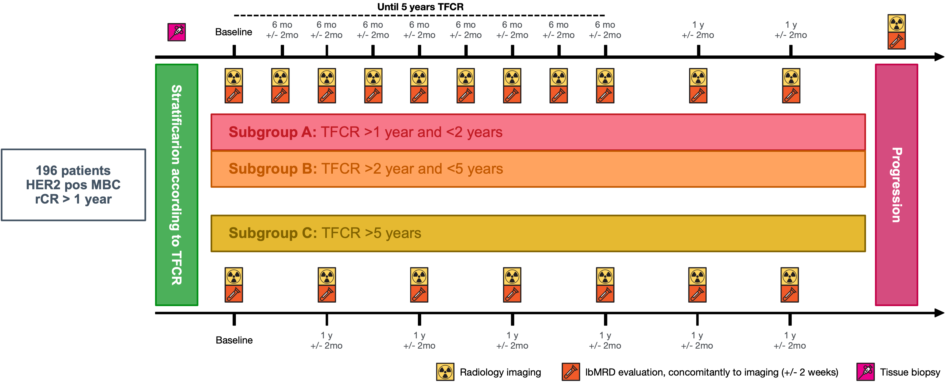
Is HER2 positive MBC always incurable?
The INSPIRE.1 Study
Prospective study focused on patients treated with antiHER2 agents for HER2 positive MBC experiencing a radiological complete response longer than 1 year.
Primary endpoint: incidence of lbMRD; Secondary endpoints: PFS, OS, lead time, sensitivity and specificity

Slide 5
Thank you
lorenzo.gerratana@uniud.it
@LGerratana
liquidbio.altervista.org
@gerratana

